Slide 1
Green must be convenient
Roberto Freato
CTO @Witailer

Slide 2
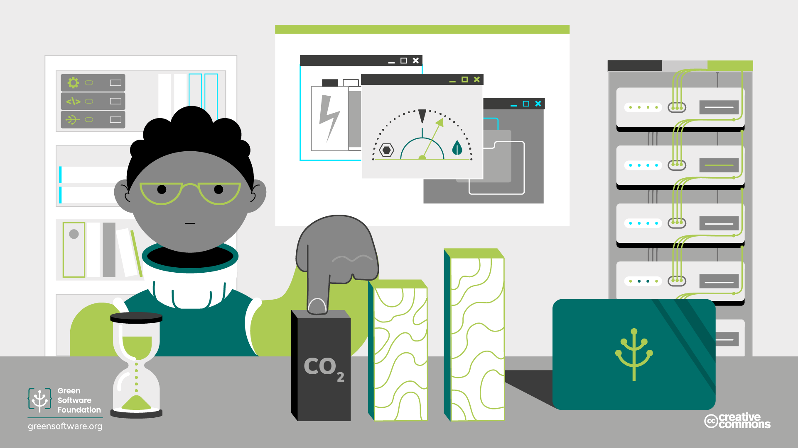
Carbon and CO2eq

Slide 3

Transition to clean

Slide 4

Acidification of Oceans
Overshoot Day

Slide 5

Overshoot Day

Slide 6
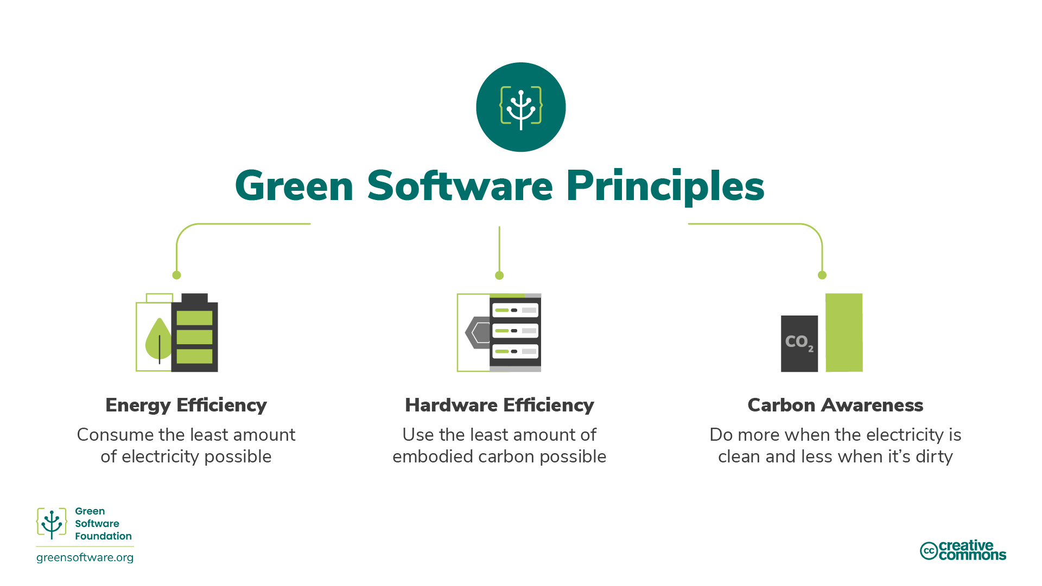

Slide 7
Energy Efficiency

Slide 8
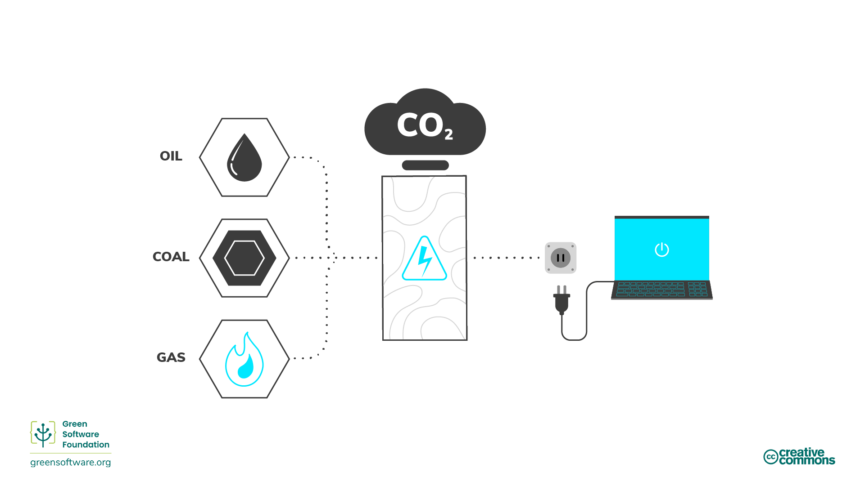

Slide 9
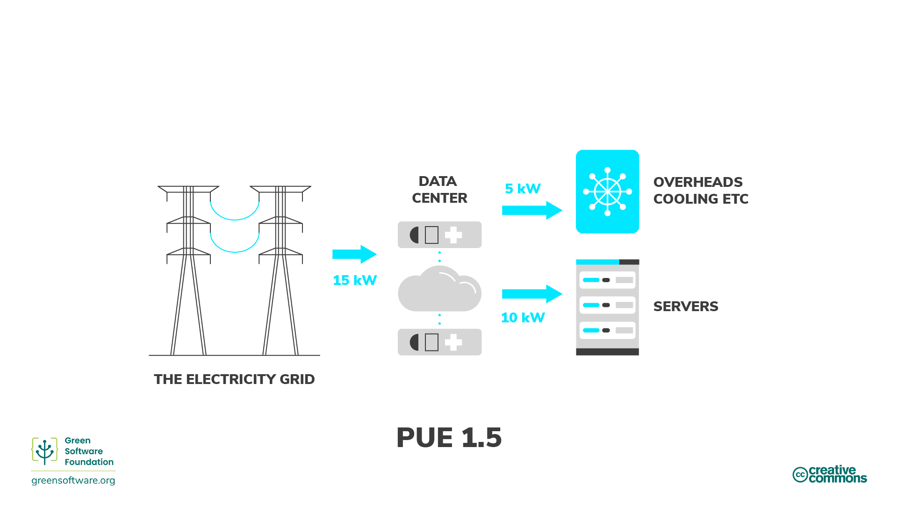

Slide 10
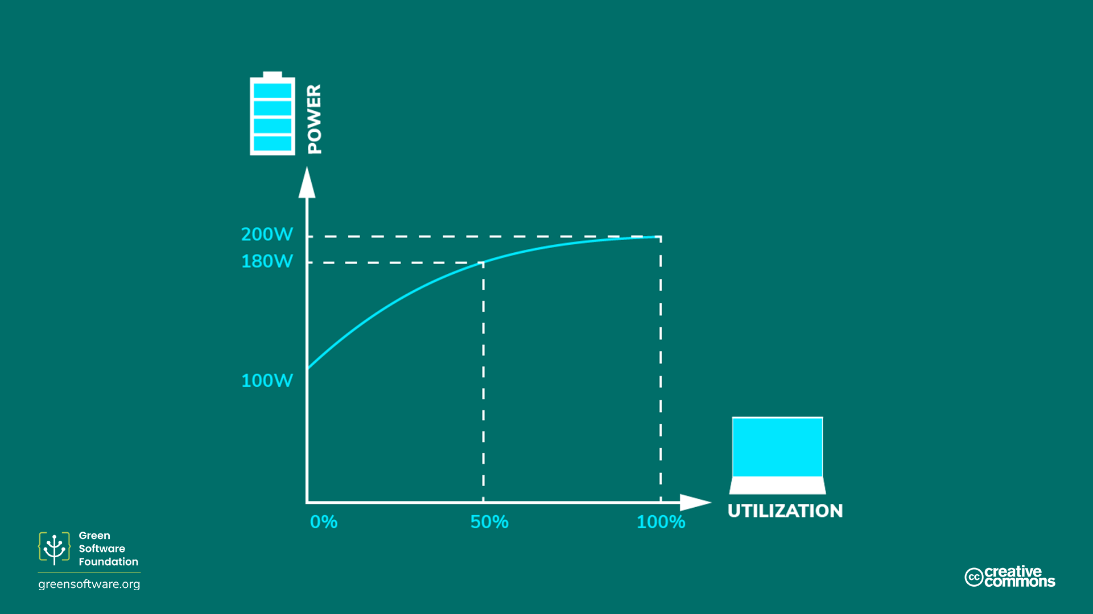

Slide 11
Hardware Efficiency

Slide 12
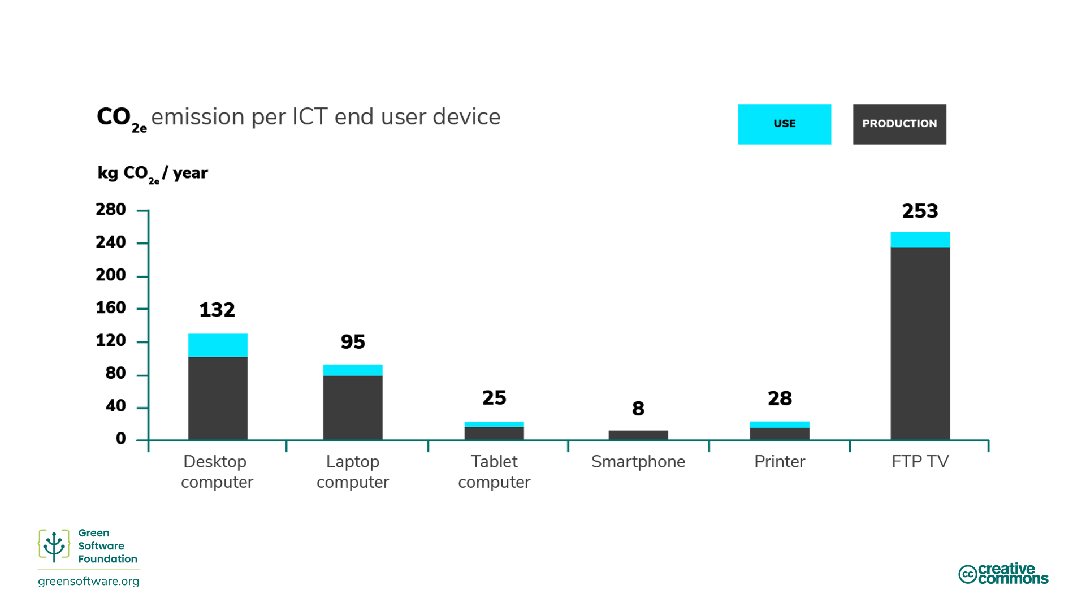

Slide 13
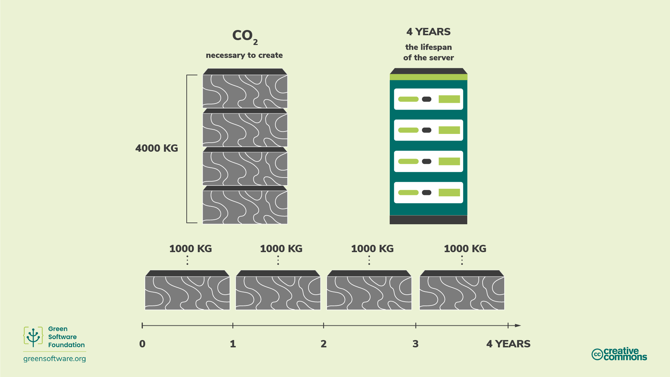

Slide 14
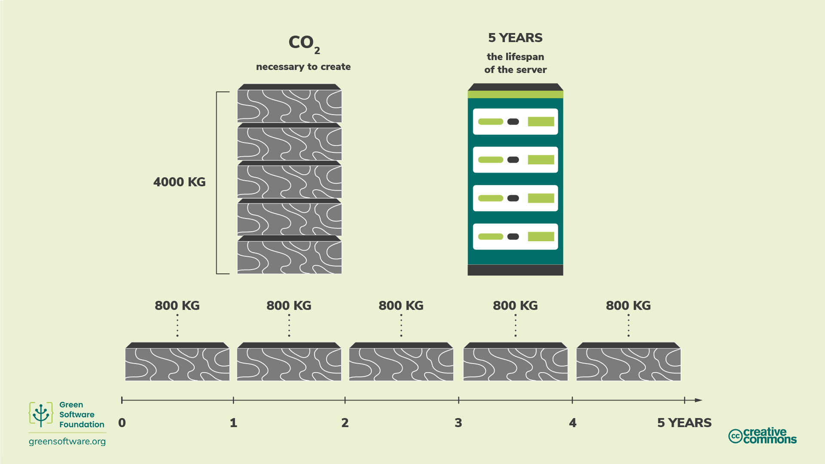

Slide 15

Increase device utilization

Slide 16
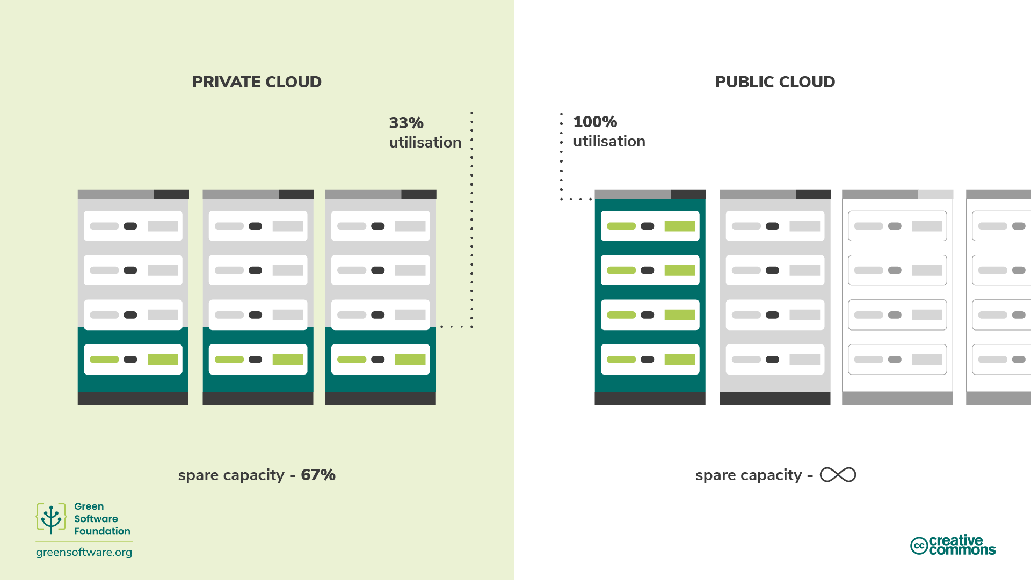

Slide 17
Carbon Awareness

Slide 18
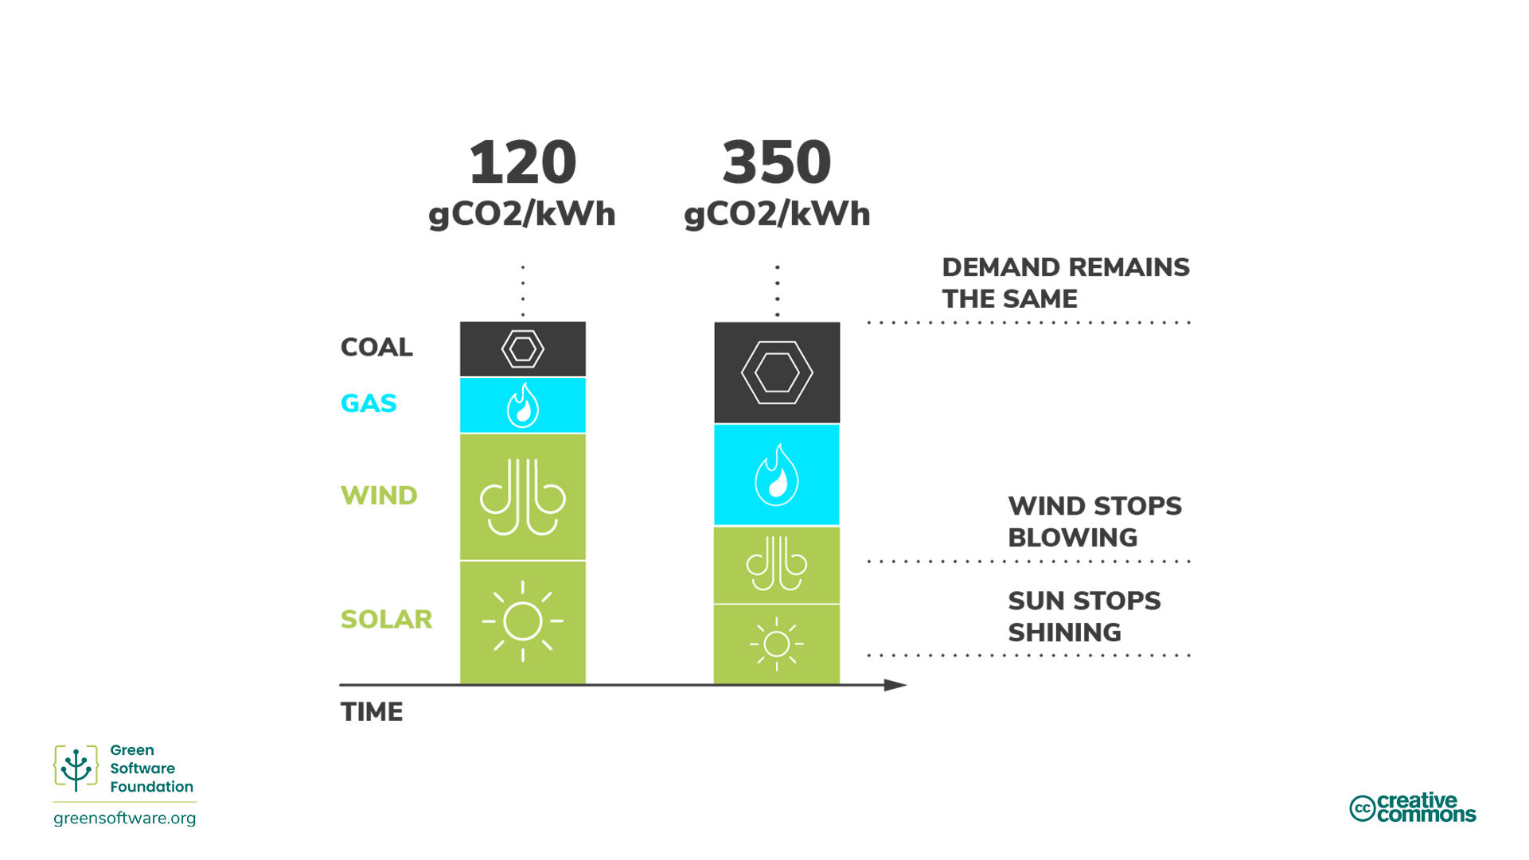

Slide 19
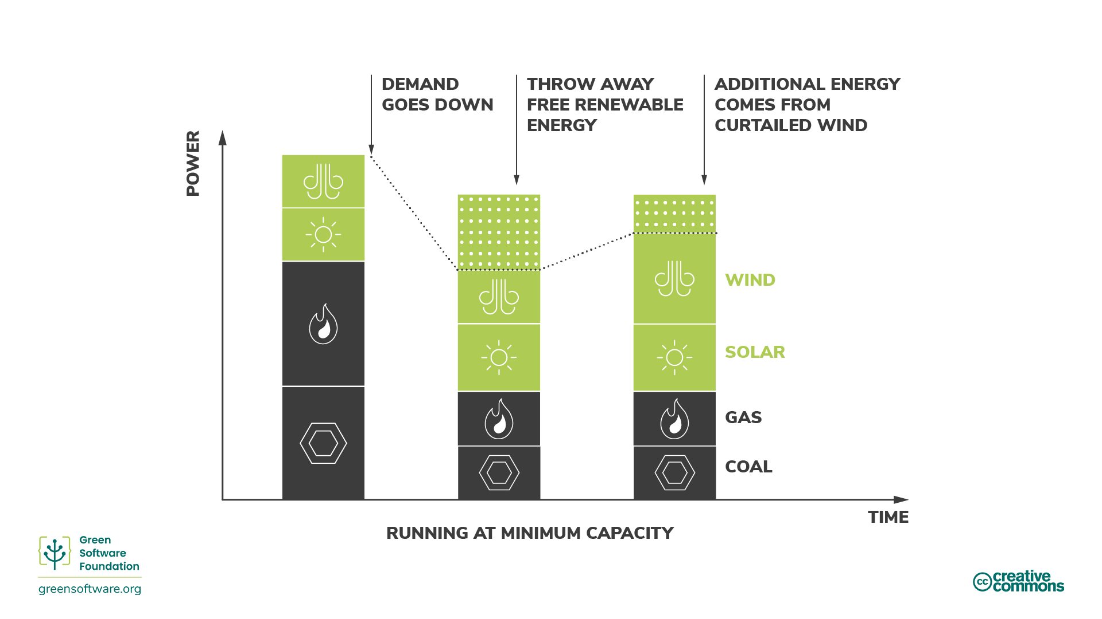

Slide 20
Shifting

Slide 21
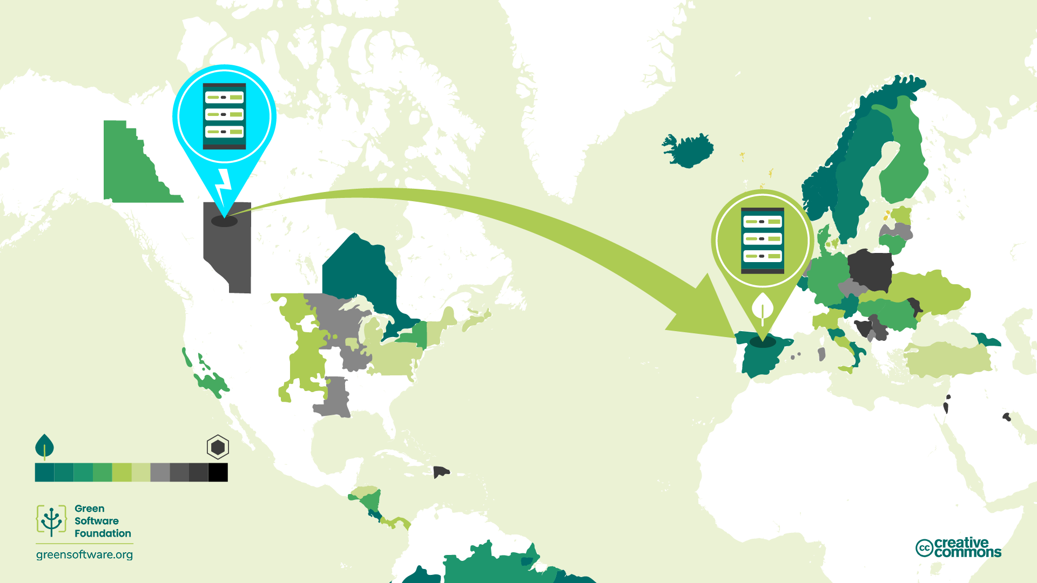

Slide 22
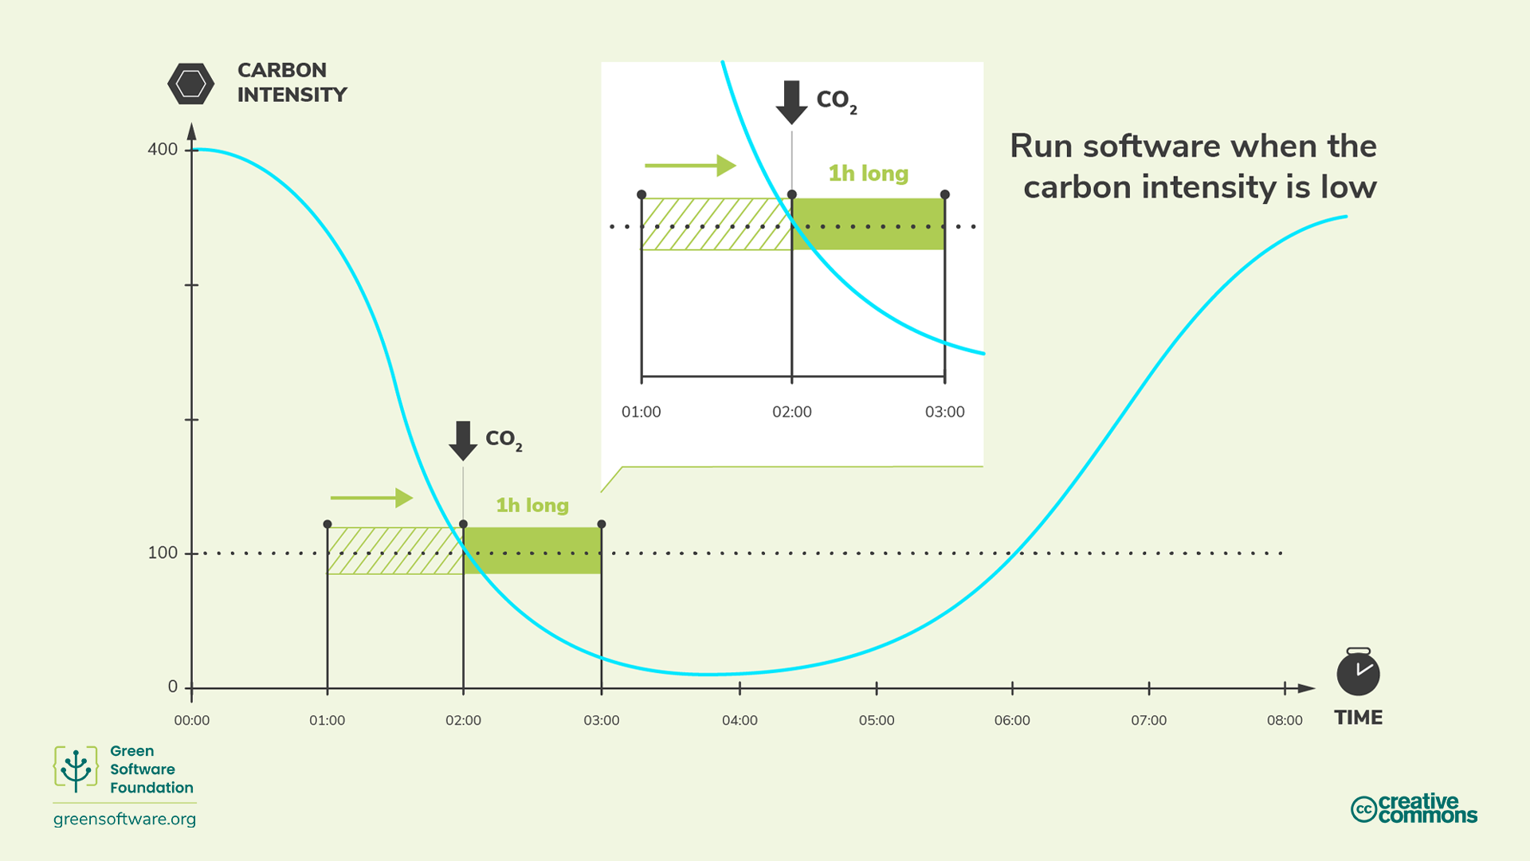

Slide 23
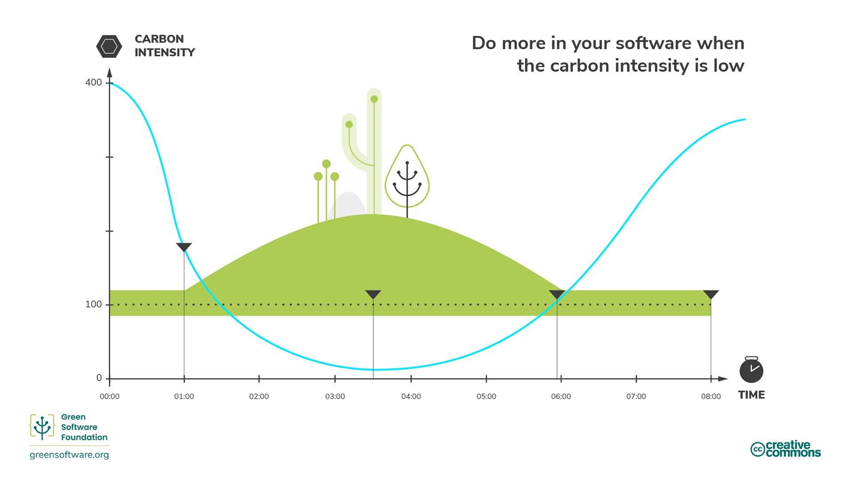

Slide 24
Matching

Slide 25
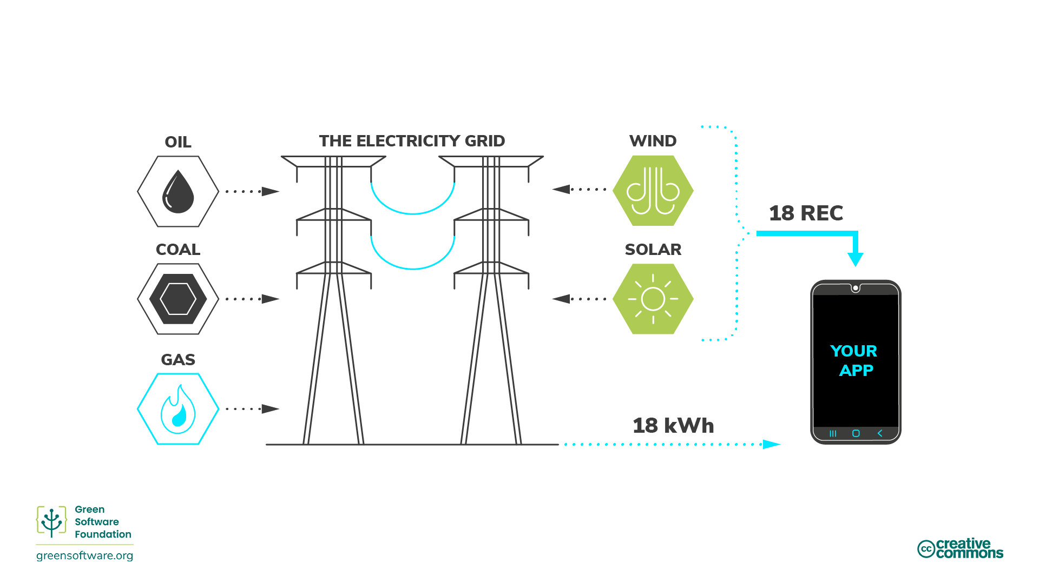

Slide 26


Slide 27
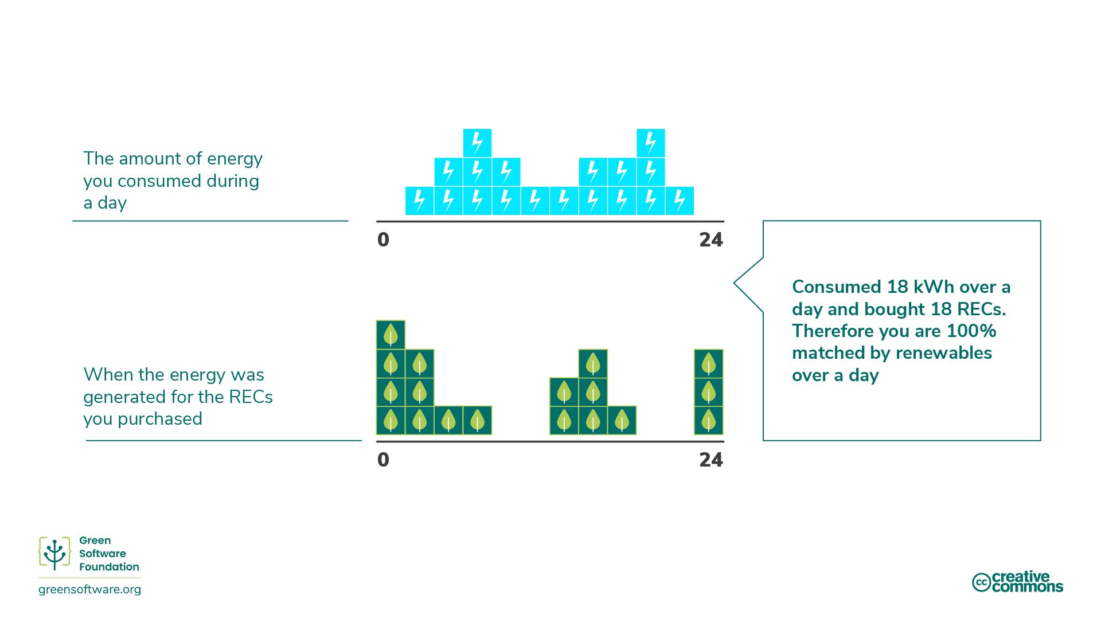

Slide 28
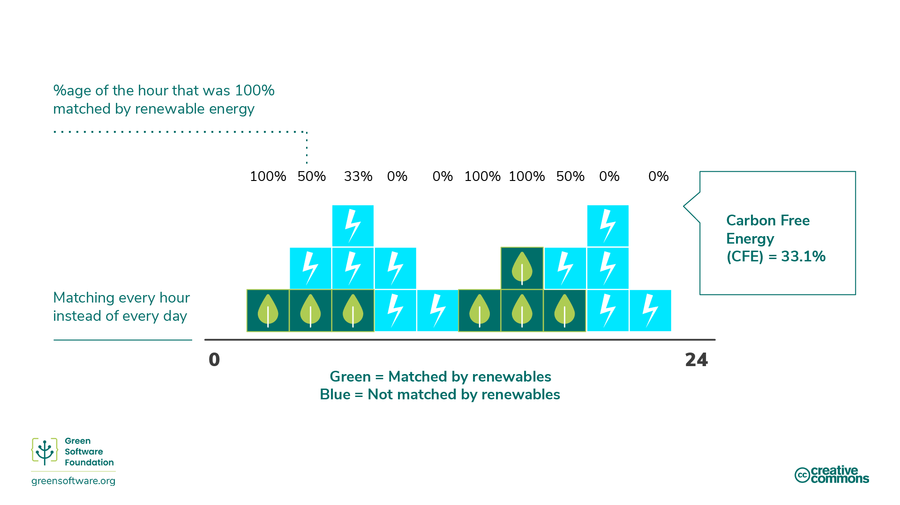

Slide 29
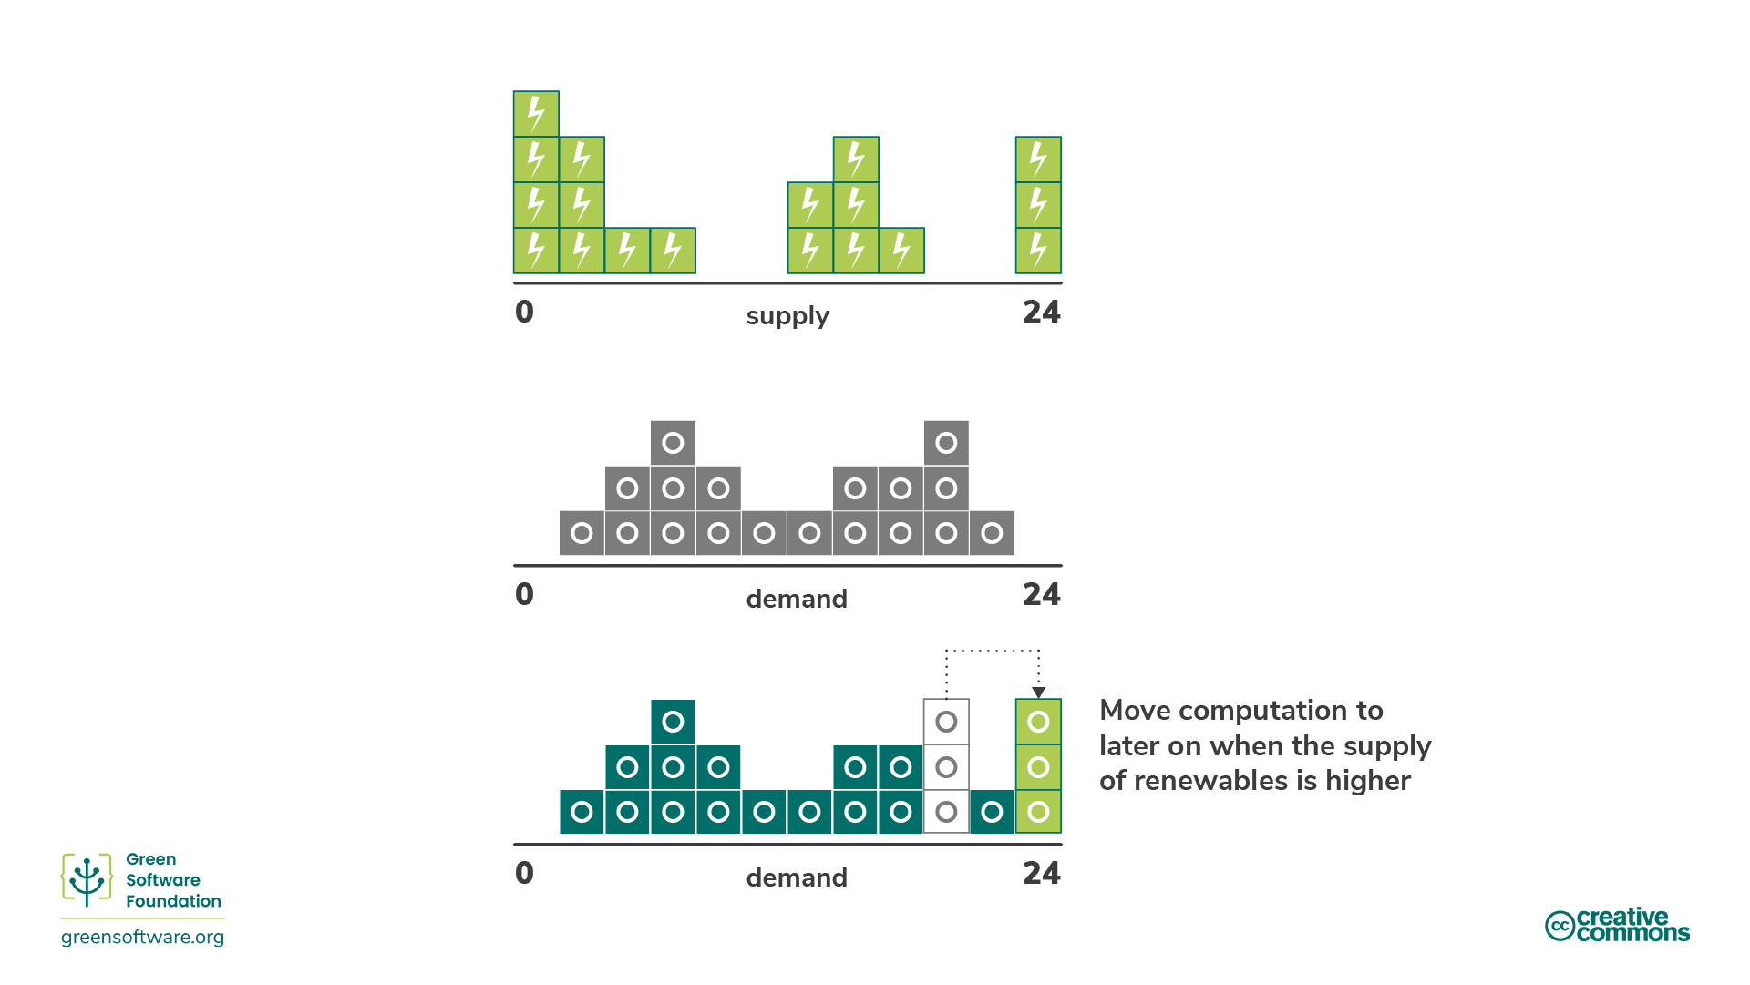

Slide 30
Carbon Neutral vs Net Zero

Slide 31
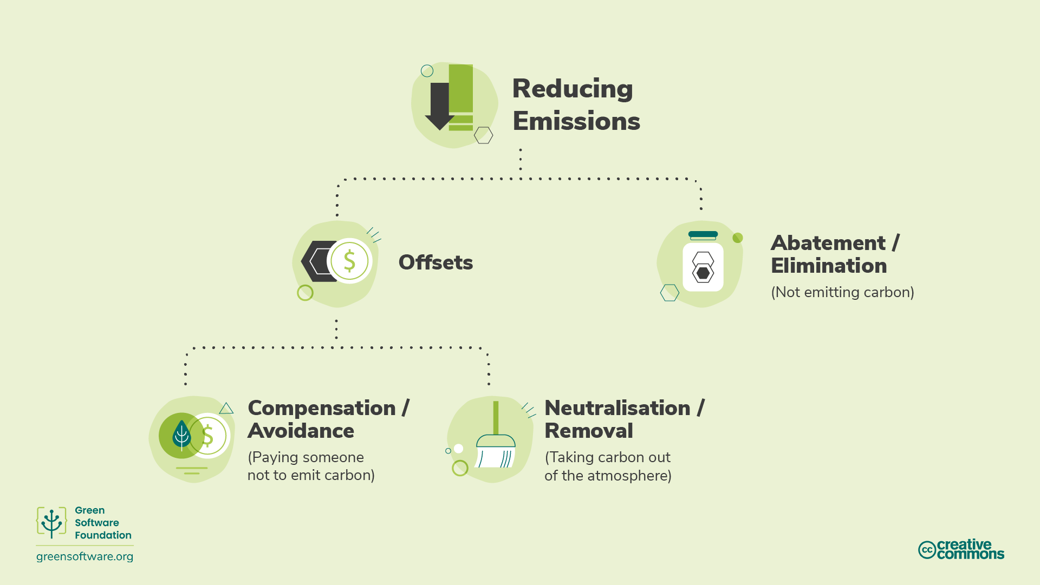

Slide 32
Measurment

Slide 33
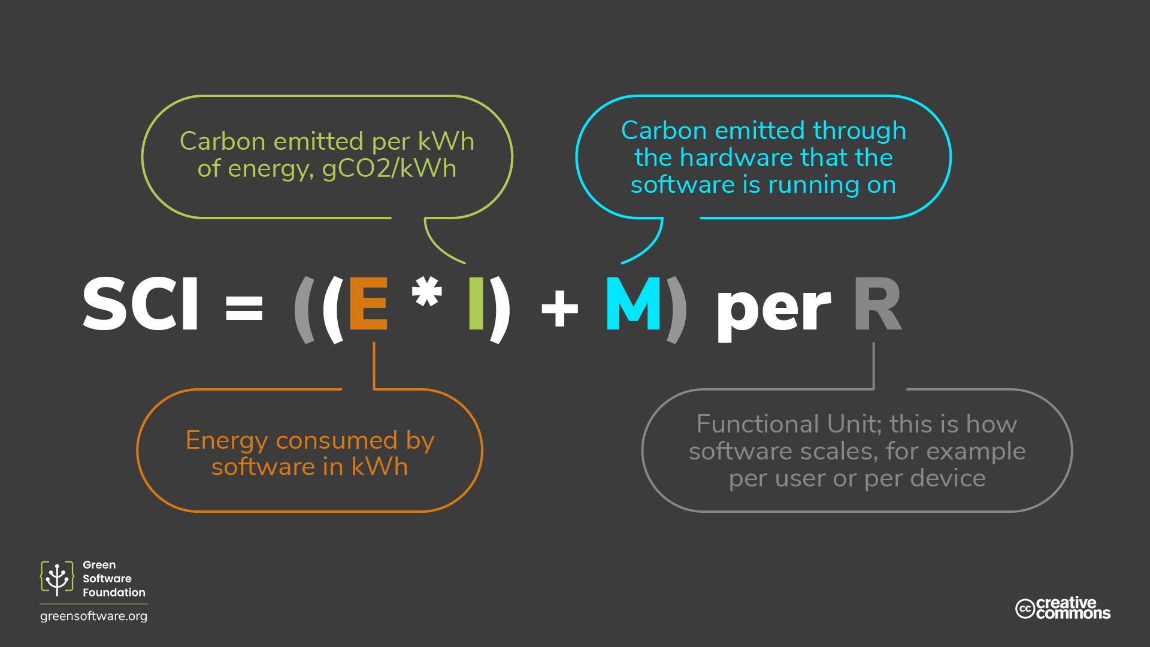

Slide 35
What’s Next

Slide 36

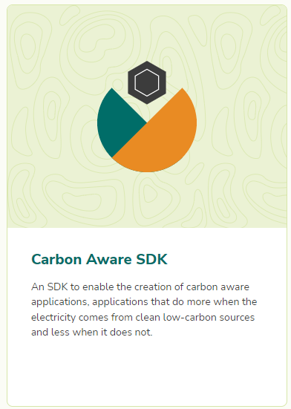


Slide 37




Slide 38



INSERIRE QR CODE CHE RICEVERETE VIA MAIL
Valuta la sessione
G R A Z I E !

